Slide 1
How to Submit a Good Virtual Field Trip for #ESA2021
Ari Martinez, 2021 Local Host
Jennifer Riem, Meeting Program Associate
Guest Panelists
Jorge Ramos, Stanford University
Angelica Patterson, Black Rock Forest
Benjamin Bravo, Sonoma State University
https://www.esa.org/longbeach/

Slide 2
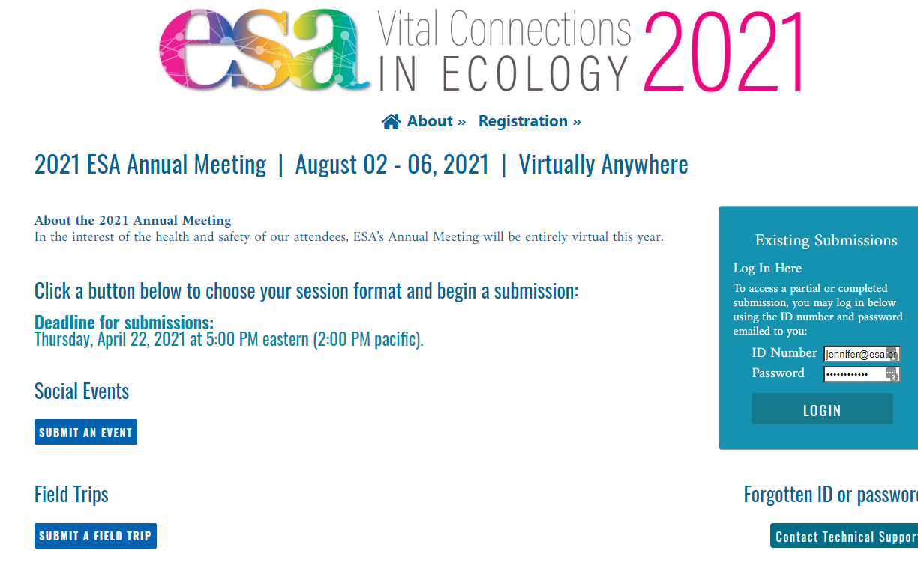
Notes:
Submission page overview. Click “Submit” for each proposal type to begin a new submission. Proposal submission link: https://eco.confex.com/eco/2021/cfp.cgi

Slide 3
Notes:
Note that two calls for proposals are open right now. Field trips are the second option on this page.

Slide 4
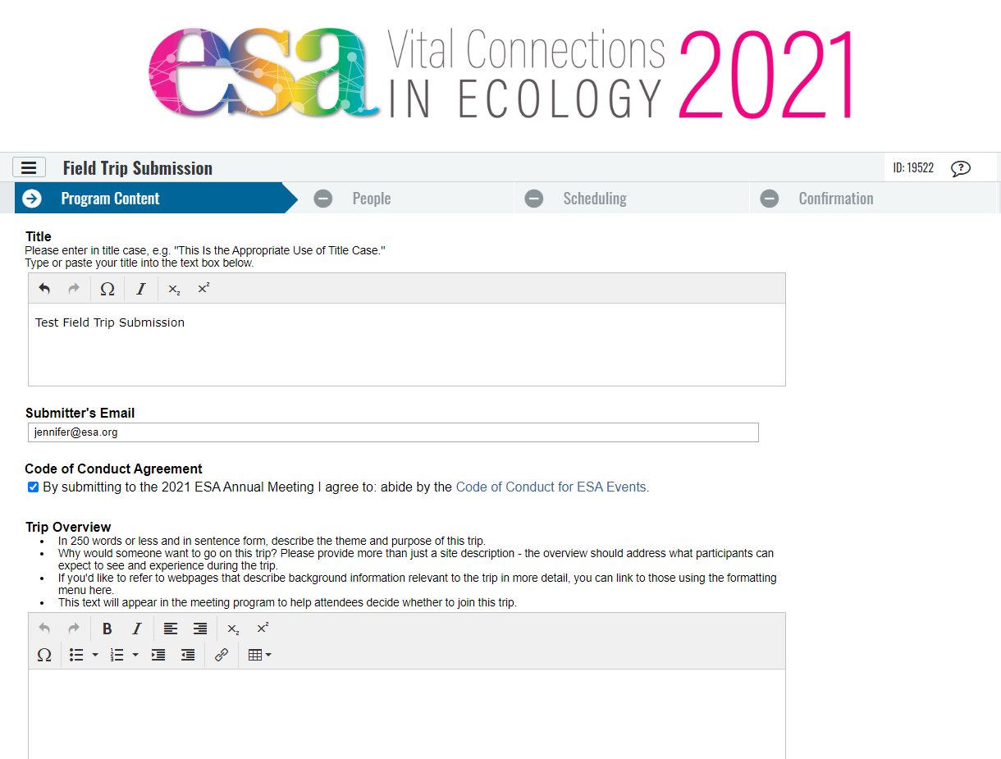
Notes:
Each session proposal has 4-5 steps. For field trips, it’s Program Content, People, Scheduling, and Confirmation. This is the top part of the Program Content step.

Slide 5
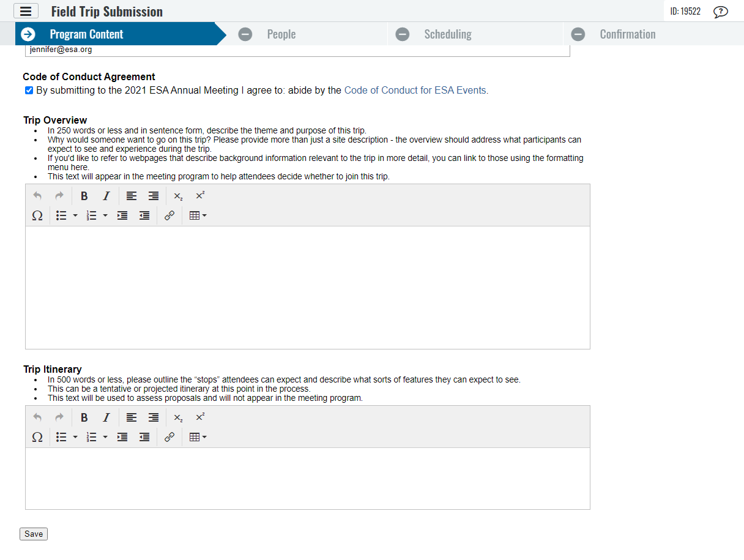
Notes:
After clicking “Save” at the bottom of this page you have completed the first step of submission. An automated email with the ID and password will be sent to the email address entered as Submitter’s Email Address. You can use these or the included link to return to edit/complete your submission until the deadline.

Slide 6
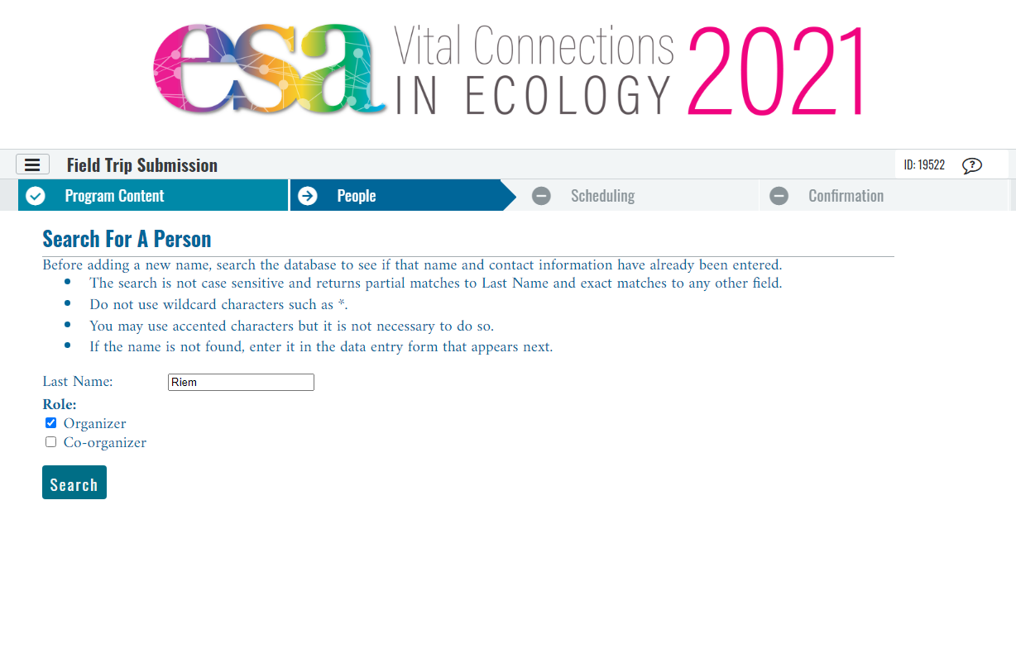
Notes:
The second step is the People step, where you will enter one organizer and any co-organizers (if any). First, search for each person by last name.

Slide 7
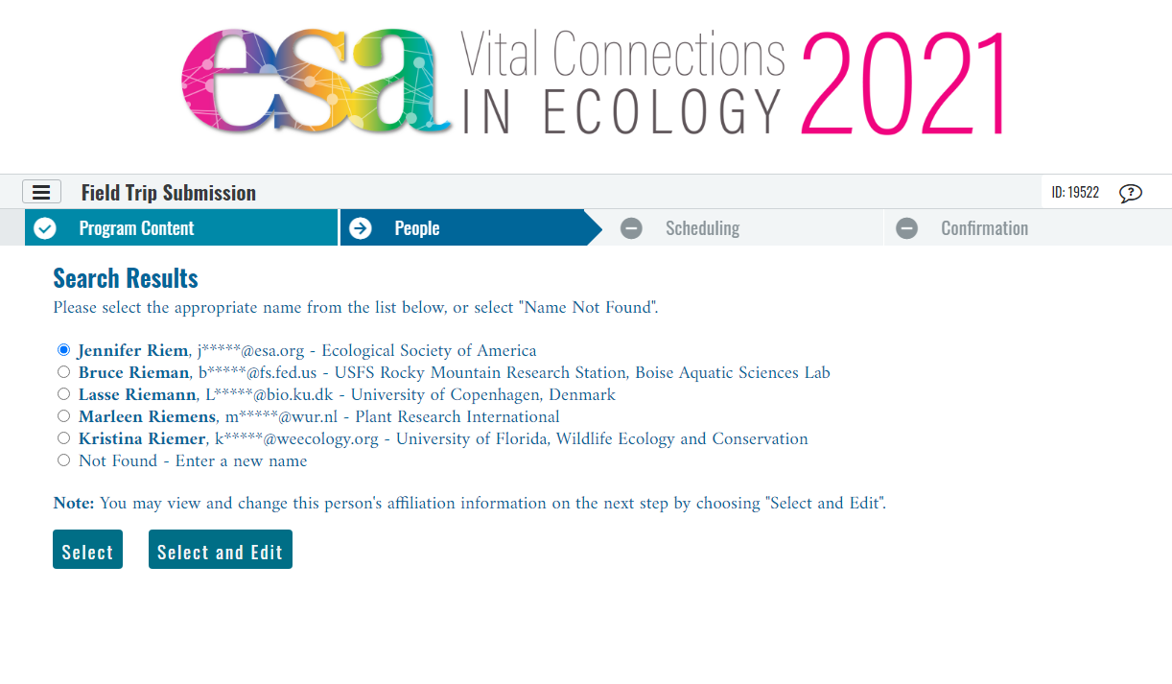
Notes:
Confirm you have found the right person in the system. You might need to edit their details in some situations, such as a recent affiliation change. If you can’t find a person listed at all, you can add them as a new name.

Slide 8
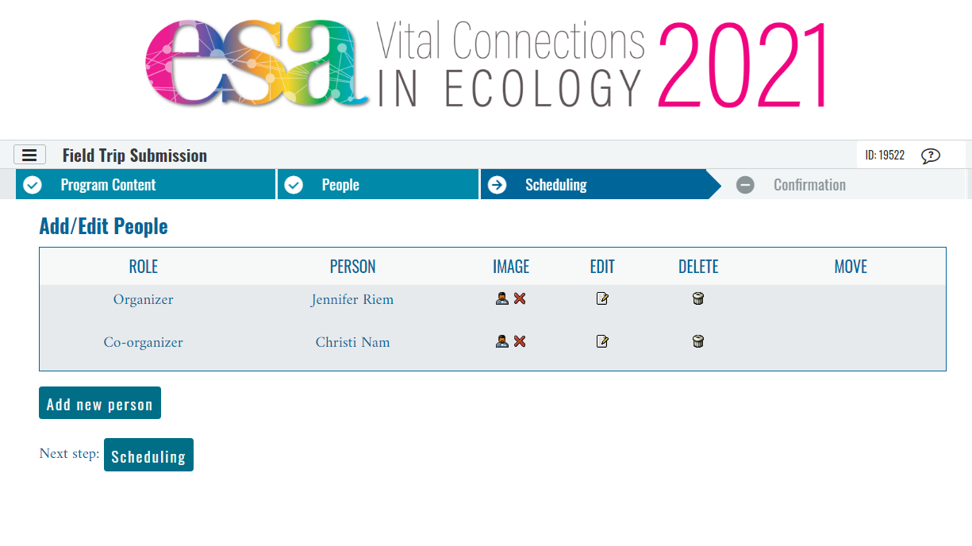
Notes:
This is a completed person list – one organizer, one co-organizer.

Slide 9
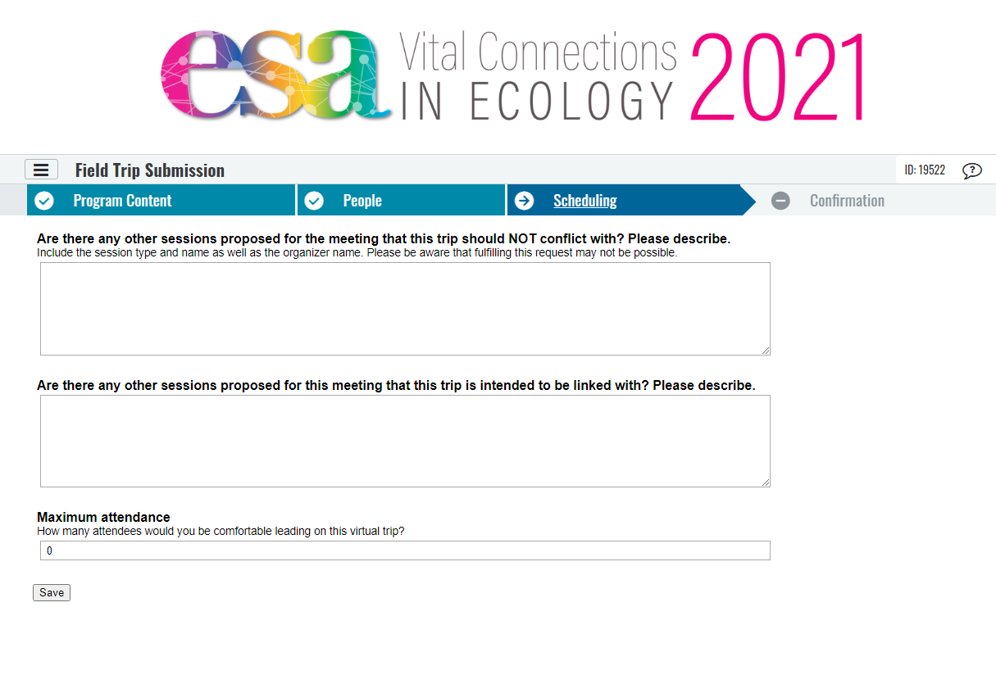
Notes:
The third step is scheduling. These questions are about known conflicts with other sessions or links with other sessions. We also ask the maximum number of attendees you think you can successfully engage in a live video format (Zoom session).

Slide 10
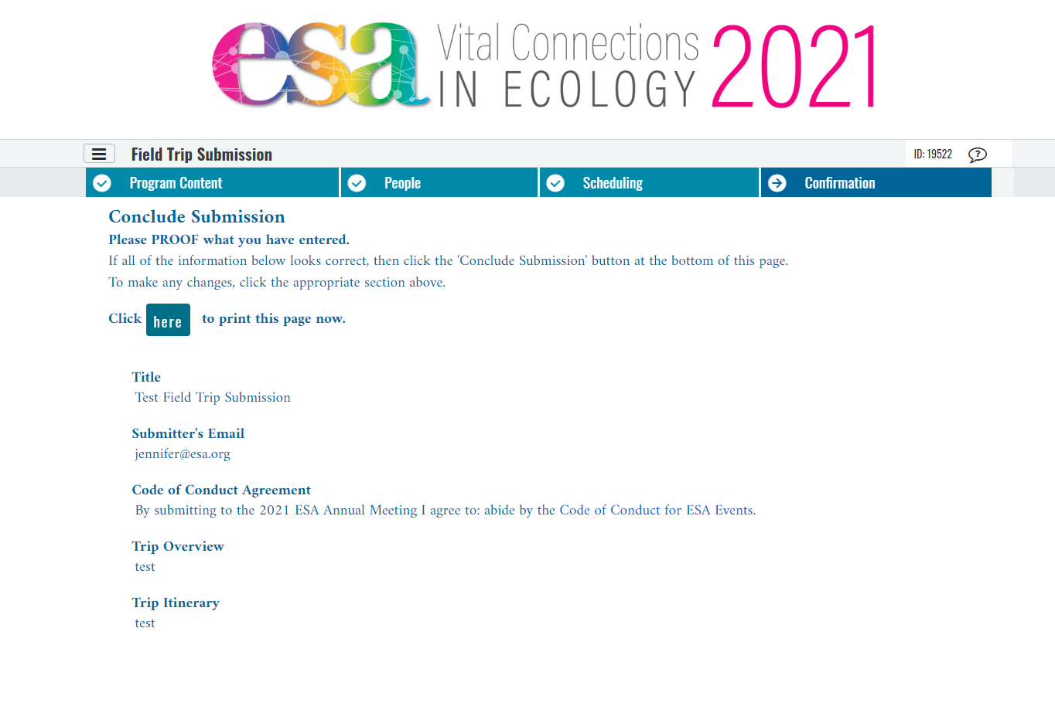
Notes:
The final step is confirmation. Please take the time to proofread and check your session details here. It makes a big difference. This is the top of the page – scroll down to check everything.

Slide 11
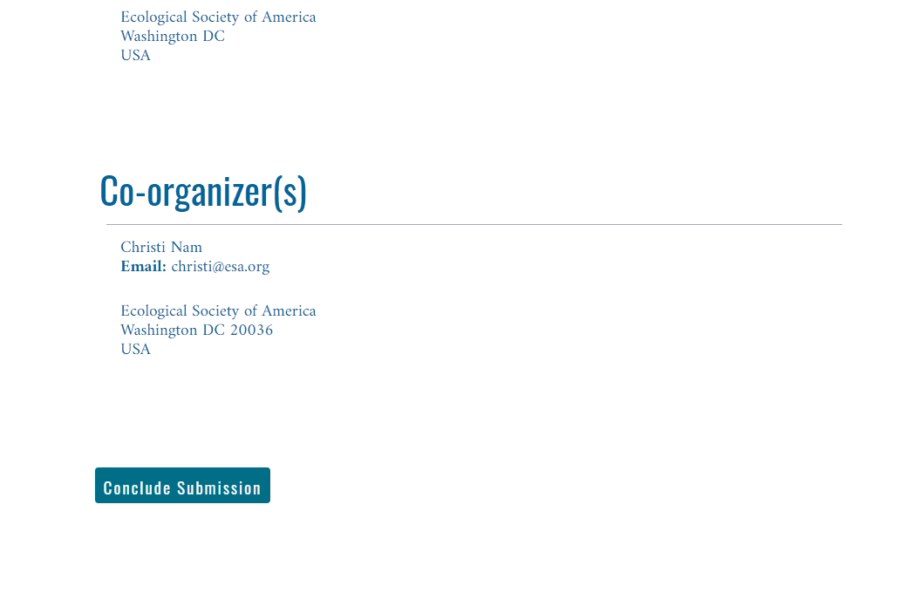
Notes:
This is the very last action – click to confirm the submission is complete. You will receive an email confirmation and a link you can use to return to make edits until the submission deadline has passed.

Slide 12
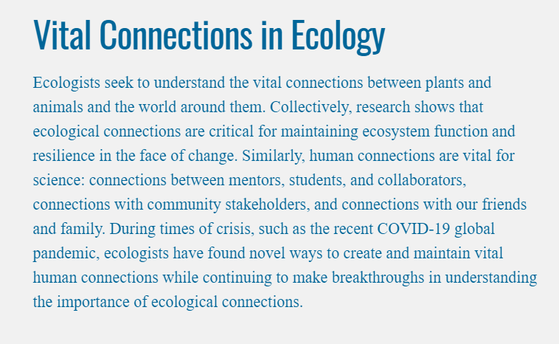
How to Submit
a Good Virtual Field Trip
2021 Meeting Theme
Notes:
This year’s meeting theme. Matching the theme is not required! Some sessions do, some sessions don’t.

Slide 13
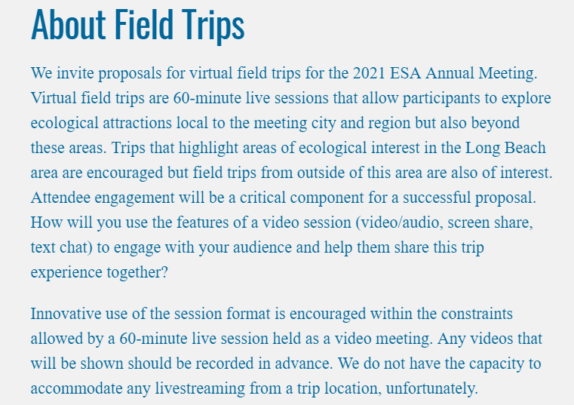
How to Submit
a Good Virtual Field Trip
Submission Guidelines
Notes:
Submission guidelines.

Slide 14
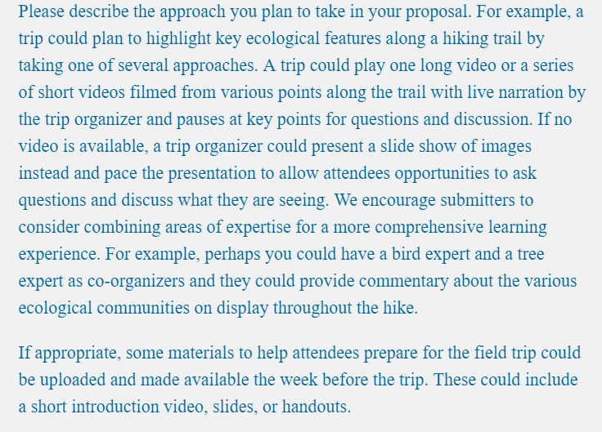
How to Submit
a Good Virtual Field Trip
Submission Guidelines
Notes:
Submission guidelines.

Slide 15
How to Submit a Good Virtual Field Trip for #ESA2021
Questions after today?
Ari Martinez 2021 Local Host
arimartinez043@gmail.com Jennifer Riem Meeting Program Associate jennifer@esa.org
https://www.esa.org/longbeach/

Slide 16
How to Submit a Good Virtual Field Trip for #ESA2021
Guest Panelists
Jorge Ramos, Stanford University
Angelica Patterson, Black Rock Forest
Benjamin Bravo, Sonoma State University

