Slide 1
ESA Water Cooler Chat The Ins and Outs of Proposing a Session for #ESA2021
Sarah Emery, 2021 Program Chair
Kiona Ogle, 2020 Program Chair
Sarah Anderson, Meetings Committee Ryan McEwan, 2019 Program Chair
Christi Nam, Director, Conventions and Meetings
Jennifer Riem, Meeting Program Associate
https://www.esa.org/longbeach/

Slide 2
Proposal Submission Link:
https://eco.confex.com/eco/2021/cfs.cgi
Notes:
Submission page overview. Click “Submit” for each proposal type to begin a new submission.
Existing submissions can be accessed by entering the ID and password in the box on the right-hand side of the screen. This ID and password is unique to every proposal submission. It’s not your member number. You should have received ID and password after completing the first step of your proposal submission.

Slide 3
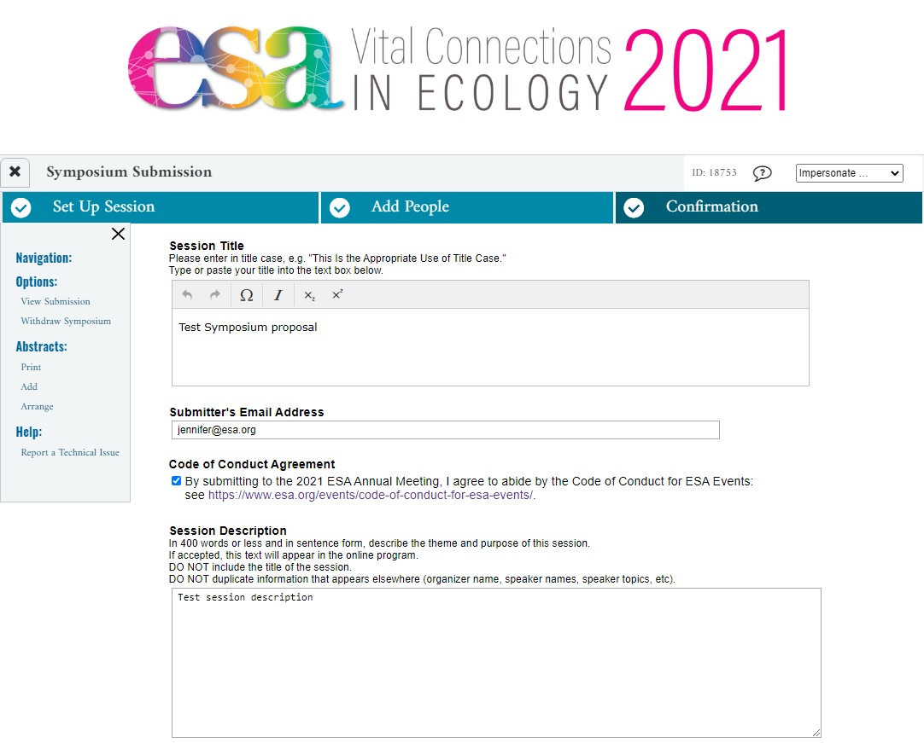
Notes:
Each proposal has 3 steps – Set Up Session, Add People, and Confirmation. Most of the content you’ll need to enter is on the Set Up Session Page. This is the top of that page. This example is for a symposium proposal.
The submitter’s email address is where an automated email will be sent after you complete the first page of this submission.

Slide 4
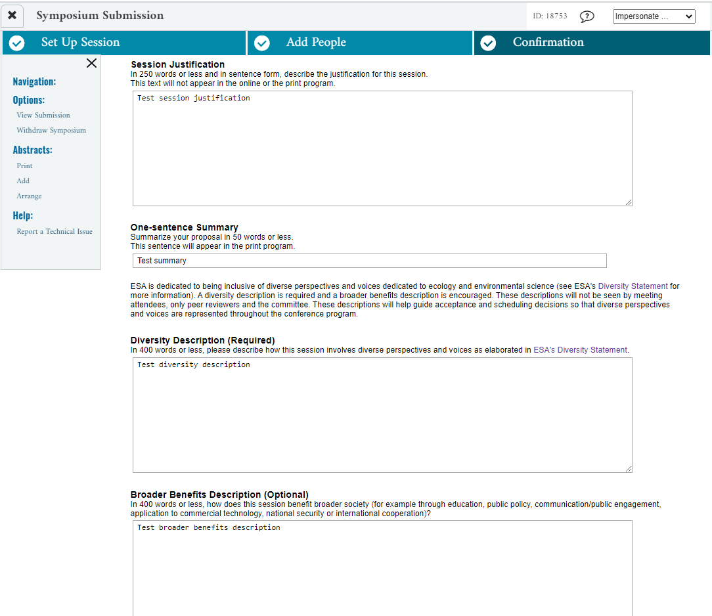
Notes:
Continuing the Set Up Session page – this is a little lower down. Please note that the Diversity Description is required this year. Broader Impacts is still optional.

Slide 5
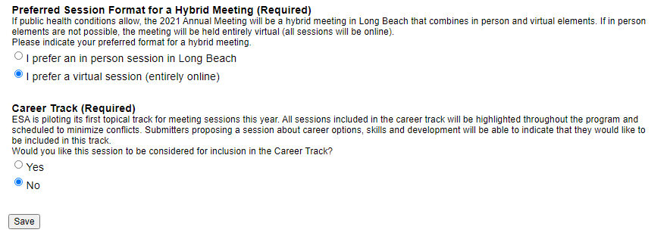
Notes:
Continuing the Set Up Session page – these are the last two questions on the page. They are both new for 2021. After clicking “Save” you have completed the first step of submission. An automated email with the ID and password will be sent to the email address entered as Submitter’s Email Address. You can use these to return to edit/complete your submission until the deadline.

Slide 6
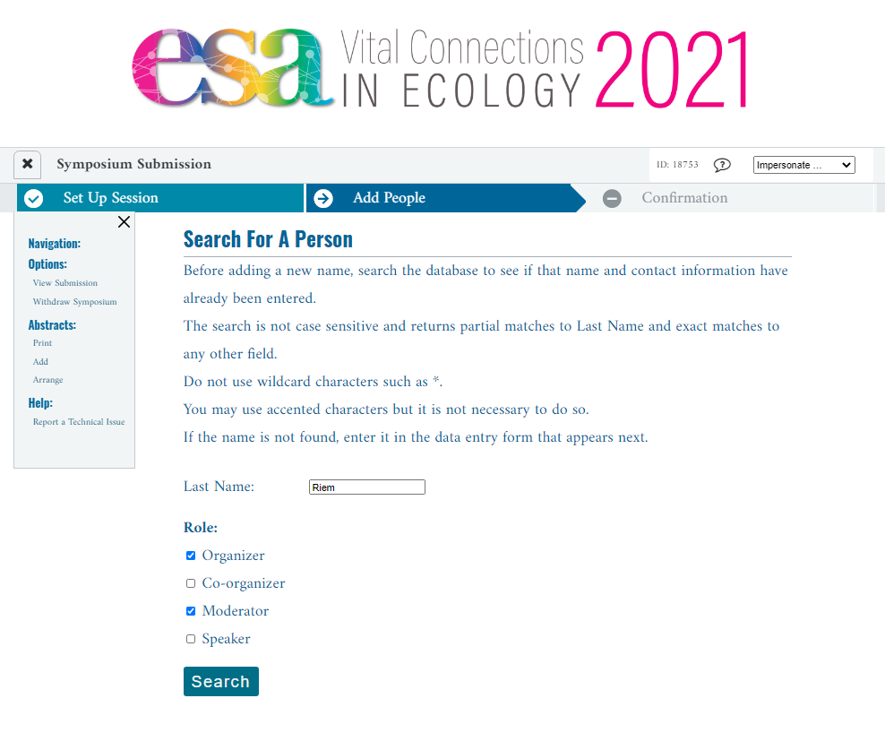
Notes:
Add People page – this is showing a last name search to add a person. Note that you should select the role(s) for the new person before proceeding. The system will adapt the list of options for roles as you enter more people. For example, if you have already added a session moderator, you will not see this option.

Slide 7
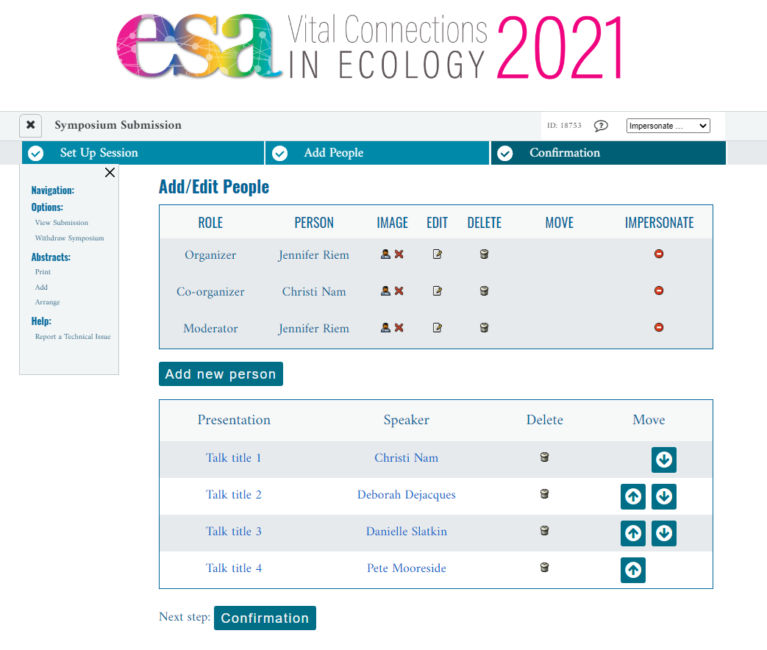
Notes:
Add People page – this is a completed example. Number of speakers for each proposal type: symposia 4, organized oral sessions 6, Inspire sessions 6-10.

Slide 8
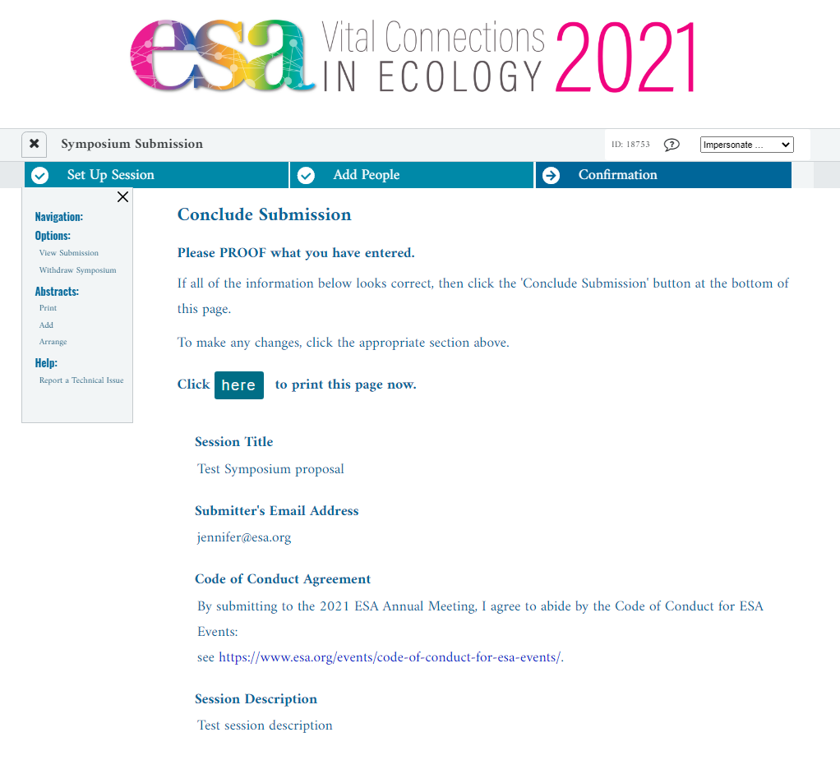
Notes:
Confirmation Step – Please proof your work! Click “Conclude Submission” at the bottom of the page to complete your submission. The Session Organizer will receive an automated email confirming the proposal has been submitted. The ID and password in that email can be used to return to the proposal to edit it until the deadline has passed.

Slide 9
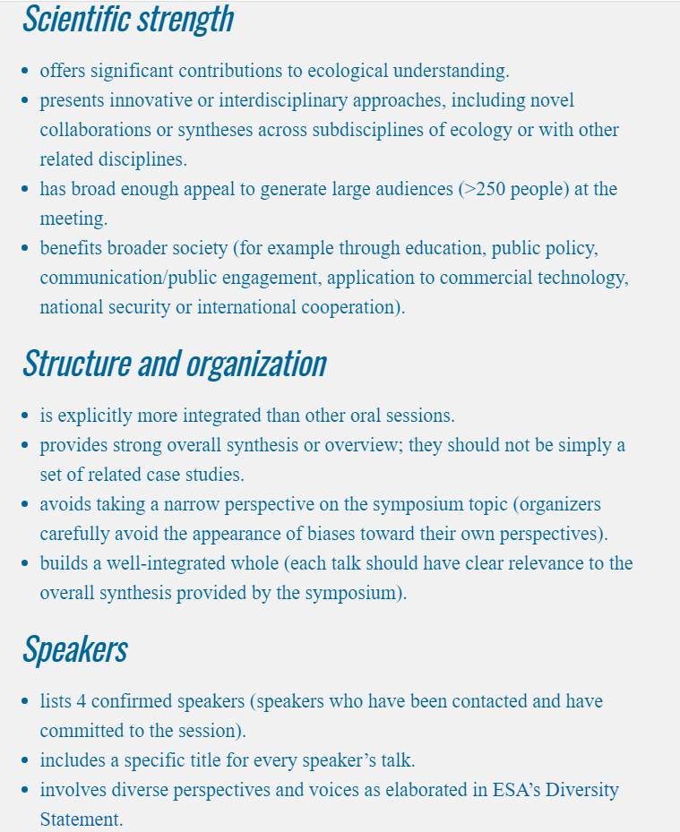
Symposium Proposal Guidelines
Notes:
https://www.esa.org/longbeach/program/symposia/

Slide 10
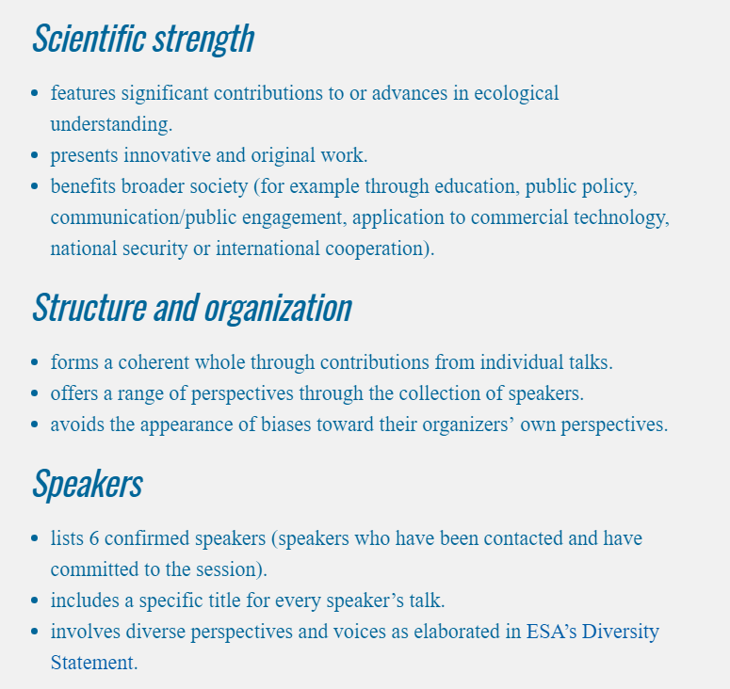
Organized Oral Session Proposal Guidelines
Notes:
https://www.esa.org/longbeach/program/organized-oral-sessions/

Slide 11
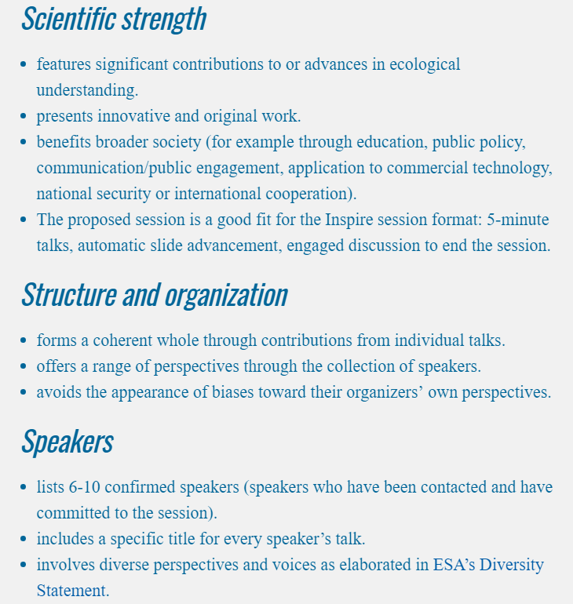
Inspire Session Proposal Guidelines
Notes:
https://www.esa.org/longbeach/program/inspire-sessions/

Slide 12
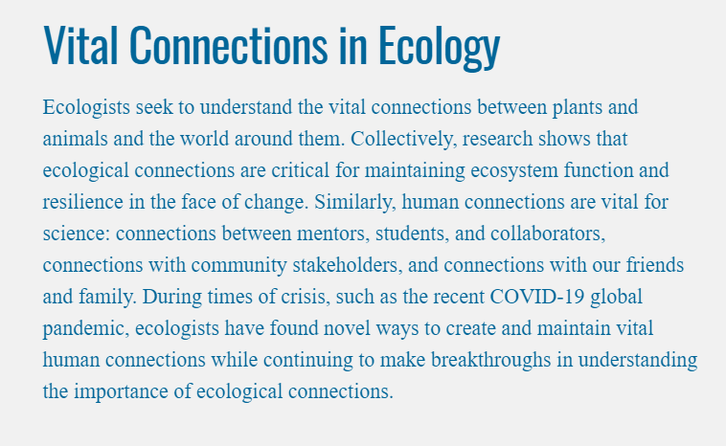
ESA Water Cooler Chat The Ins and Outs of Proposing a Session for #ESA2021
2021 Meeting Theme

Slide 13
ESA Water Cooler Chat The Ins and Outs of Proposing a Session for #ESA2021
Questions after today?
Sarah Emery 2021 Program Chair sarah.emery@louisville.edu Jennifer Riem Meeting Program Associate jennifer@esa.org
https://www.esa.org/longbeach/

