Slide 1
What is a “large” lecture?
Sarah Shannon Firestone

Slide 2
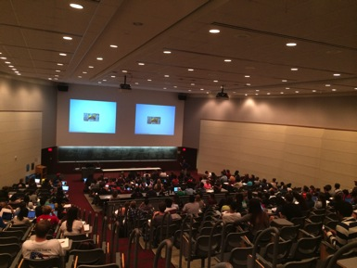
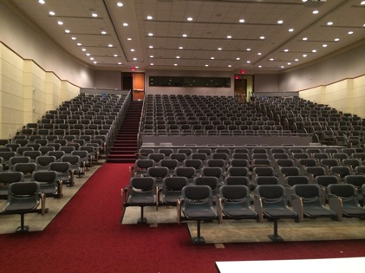
How big is “large”?

Slide 3
How big is “large”?
48% of studies evaluated student performance compared to a control or model
Notes:
Do a survey of the audience. How big is the largest class you regularly teach?
100-200?
200-300?
300-400
> 400
Explain graph. I searched the peer-reviewed literature using keywords “large” and “lecture”. These were the first 50 studies I found that were not review papers, meta-analyses, or opinion pieces. Studies that describe their course as a large lecture cover courses ranging in size from 70 students to 600 students. The five studies on the right did not give the number of students in the class.
Yellow diamonds are studies that assessed whether their teaching technique improved student performance compared to either a control group or each student’s predicted performance in the course using a mathematical model. Dark blue diamonds either did not assess student performance at all or simply found that students improved over the duration of the course. Only 24 studies (48%) assessed student performance.
Teaching techniques that work in a class of 100 are not necessarily going to

Slide 4
Issues with scaling up
Student:teacher ratio
  questions
  grading
Time to transition between activities
Collecting or handing out materials
“Housekeeping” time

Slide 5
Playing Devil’s Advocate:
Why wouldn’t active learning work?
Is it active learning, or moving slower through content?
Studies change student:teacher ratio
Replications only succeed 54% of time
  (Makel and Plucker 2014)
No evidence for 10-minute “rule”
  (Wilson and Korn 2007)

Slide 6
Freeman et al. 2014

Slide 7
Success of activities in larger classes
(> 110 students)
worksheets
tutorials
case studies
group work
Freeman et al. 2014

Slide 8
group work
quizzes/practice exams
clickers
challenge questions
case studies
PBL
IntDem
“Groups +” : group work with
quizzes, practice exams, and clickers

Slide 9
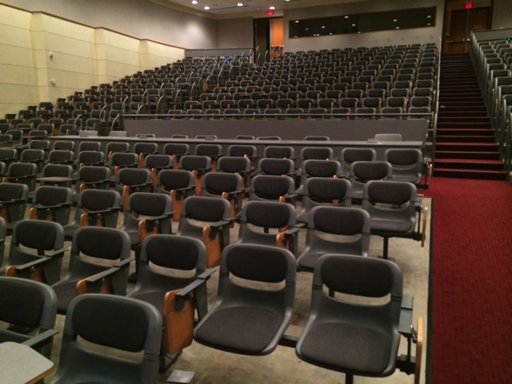
Adapt successful learning strategies for larger lectures
Modified minute paper (Harwood 1996)
UTAs
Peer grading

Slide 10
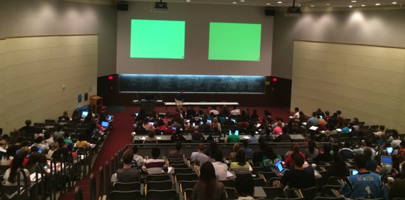
Conclusions
Research
  Need more studies in larger classes
  Assess student improvement
  Report class sizes
Teaching
  Quizzes
  Practice exams
  Clickers
  Group work

Slide 11
Freeman et al. 2014

