Slide 1
Partnership for Undergraduate Life
Sciences Education (PULSE):
Transforming Life Sciences Education
Life Discovery – Doing Science Education Conference
Oct. 3-4, 2014
Presenter:
Elizabeth (Betsy) A. Desy, Professor of Biology, Science Department, Southwest Minnesota State University, Marshall, MN.
  Email: betsy.desy@smsu.edu.

Slide 2
What is PULSE?
Partnership for Undergraduate Life Sciences Education, debuted 2012
  Collaborators--National Science Foundation (NSF), National Institutes of Health/NIGMS (NIH/NIGMS), and Howard Hughes Medical Institute (HHMI)
  Developed to stimulate systemic changes within biology departments at colleges/universities.
    based upon findings from the 2011 Vision and Change in Undergraduate Biology Education: A Call to Action .

Slide 3
Who is PULSE?
Forty PULSE Fellows chosen nationally
  charged with developing a framework for Vision and Change (V&C) implementation at the department level.
  Fellows use meetings, conference calls, and input from PULSE community (that is YOU!) to develop strategies to implement V&C recommendations.
Seeking more collaborators
  check out www.pulsecommunity.org

Slide 4
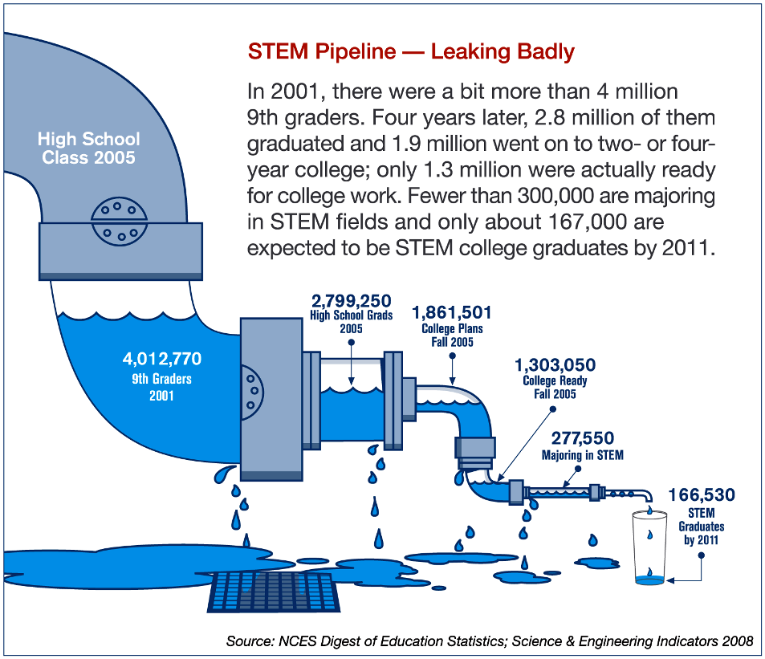
Why Change? What’s the Urgency?
STEM Pipeline is
Leaking Badly*
* PCAST predicts a deficit of 1M graduates in STEM fields
over the next decade
Notes:
Given the primacy of V&C promotion, what are the motivations to change?
----- Meeting Notes (10/31/13 12:54) -----
and for those who do persist, change to a student-centered curriculum works better!

Slide 5
V&C Vision For Implementing Change
Integrate core concepts & competencies for biological literacy throughout curriculum
Focus on student-centered learning
Promote a campus-wide commitment to change
Engage the Biology community in the implementation of change

Slide 6
Vision and Change Core Competencies for Biological Literacy www.visionandchange.org
1. ABILITY TO APPLY THE PROCESS OF SCIENCE
2. ABILITY TO USE QUANTITATIVE REASONING
3. ABILITY TO USE MODELING AND SIMULATION
4. ABILITY TO TAP IN TO THE INTERDISCIPLINARY NATURE OF SCIENCE
5. ABILITY TO COMMUNI CATE AND COLLABORATE WITH OTHER DISCIPLINES
6. ABILITY TO UNDERSTAND THE RELATIONSHIP BETWEEN SCIENCE AND SOCIETY

Slide 7
Vision and Change Core Concepts for Biological Literacy www.visionandchange.org
Evolution
Structure and Function
Information Flow, Exchange, and Storage
Pathways and Transformations of Energy and Matter
Systems

Slide 8
PULSE Initiatives
Develop self-assessment rubrics to aid departments in evaluating their progress vis a vis V&C reform
Develop certification for departments whose curriculum aligns with V&C
Develop and offer online and regional workshops
Train V&C Ambassadors to work as departmental facilitators
Provide resources & regional networking opportunities for faculty and departments

Slide 9
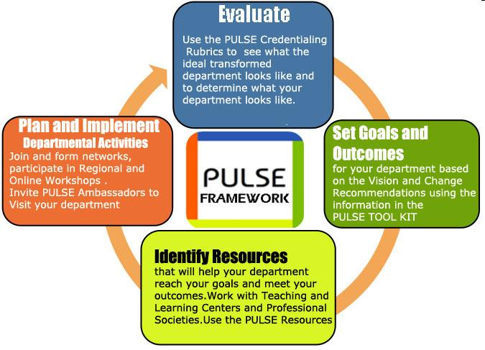
PULSE Framework for Change

Slide 10
Action Plan
    Identify strategies to implement V&C recommendations into individual course(s)
    Identify strategies to implement (or ratchet-up) V&C recommendations in programs and departments
    Identify leverage points with other significant institutional events such as national accreditation organizations
    Identify ONE collaborative action with regional colleagues.

Slide 11
PULSE Regional Meetings
Pacific Northwest
Great Plains and Midwest
New England
Southeast

Slide 12
Alignment of V&C Core Concepts
With Next Generation Science Standards www.nextgenscience.org
Evolution
  MS. Natural Selection and Adaptations
  HS. Natural Selection and Evolution
Structure and Function
  MS. Structure, Function, and Information Processing
  HS. Structure and Function
Information Flow, Exchange, and Storage
  HS. Inheritance and Variation of Traits

Slide 13
Alignment of V&C Core Concepts
With Next Generation Science Standards (continued) www.nextgenscience.org
Pathways and Transformations of Energy and Matter
  MS. Matter and Energy in Ecosystems
  HS. Structure and Properties of Matter
  HS. Energy
Systems
  MS. Interdependent Relationships in Ecosystems
  MS. Earth’s Systems
  HS. Matter and Energy in Organisms and Systems
  HS. Earth’s Systems

Slide 14
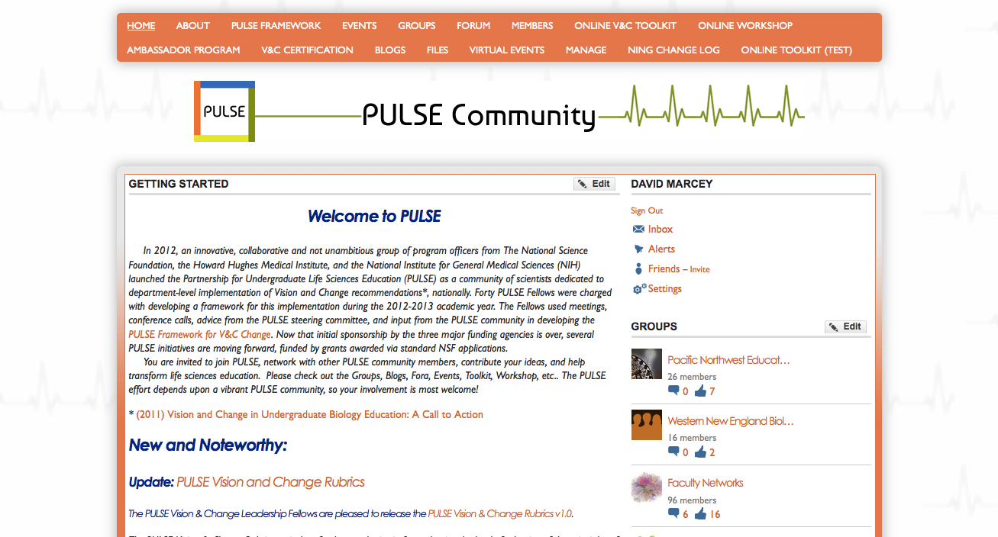
www.pulsecommunity.org

Slide 15
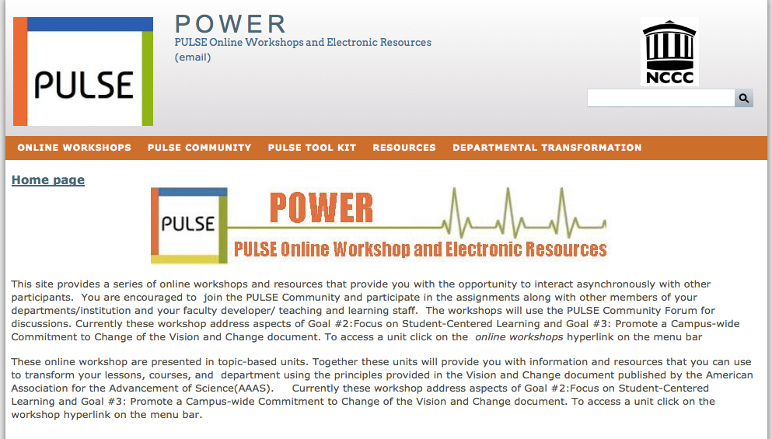
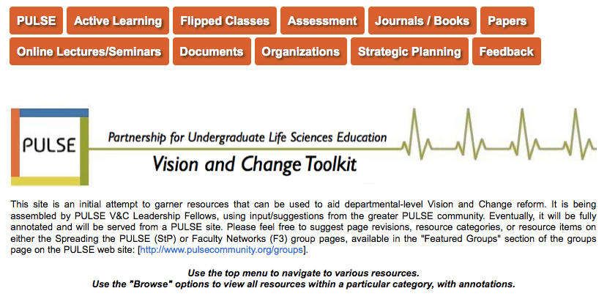
Online Workshop
Online Toolkit

Slide 16
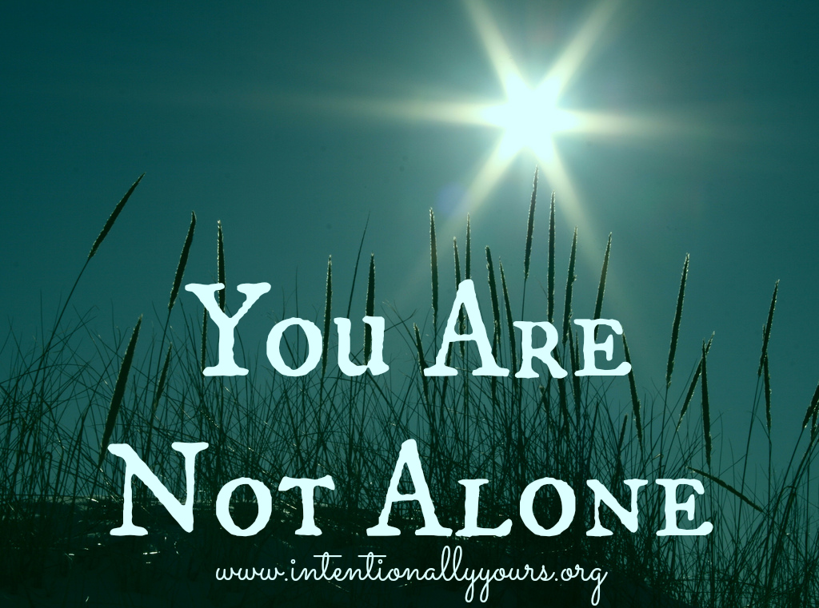
www.pulsecommunity.org

